Slide 1




Spring Security
User Accounts Stored in Database
m

Slide 2
Database Access
•
So far, our user accounts were hard coded in Java source code
•
We want to add database access
Advanced
www.luv2code.com

Slide 3






Recall Our User Roles
User ID | Password | Roles
john | test123 | EMPLOYEE
mary | test123 | EMPLOYEE, MANAGER
susan | test123 | EMPLOYEE, ADMIN
www.luv2code.com

Slide 4




Database Support in Spring Security
Out-of-the-box
•
Spring Security can read user account info from database
•
By default, you have to follow Spring Security’s predefined table schemas
Spring Security
JDBC
Code
www.luv2code.com

Slide 5
Customize Database Access with Spring Security
•
Can also customize the table schemas
•
Useful if you have custom tables specific to your project / custom
•
You will be responsible for developing the code to access the data
JDBC, Hibernate etc …
www.luv2code.com

Slide 6




Database Support in Spring Security
Out-of-the-box
•
Follow Spring Security’s predefined table schemas
Spring Security
JDBC
Code
www.luv2code.com

Slide 7
Development Process
Step-By-Step
Develop SQL Script to set up database tables
Add database support to Maven POM file
Create JDBC properties file
Define DataSource in Spring Configuration
Update Spring Security Configuration to use JDBC
www.luv2code.com

Slide 8



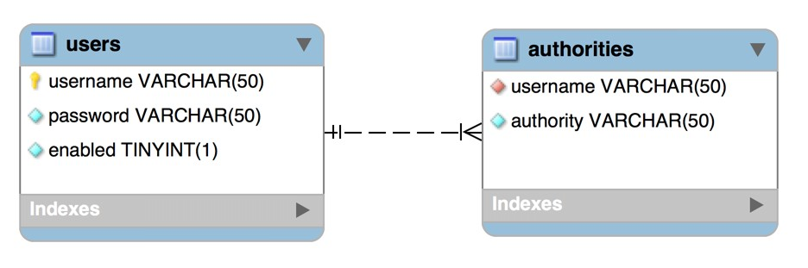
Default Spring Security Database Schema
“authorities” same as “roles”
www.luv2code.com

Slide 9


Step 1: Develop SQL Script to setup database tables
CREATE TABLE `users` (
`username` varchar(50) NOT NULL,
`password` varchar(50) NOT NULL,
`enabled` tinyint(1) NOT NULL,
PRIMARY KEY (`username`)
) ENGINE=InnoDB DEFAULT CHARSET=latin1;
www.luv2code.com

Slide 10





Spring Security Password Storage
In Spring Security 5, passwords are stored using a specific format
{id}encodedPassword
ID Description
noop | Plain text passwords
bcrypt | BCrypt password hashing
… | …
www.luv2code.com

Slide 11




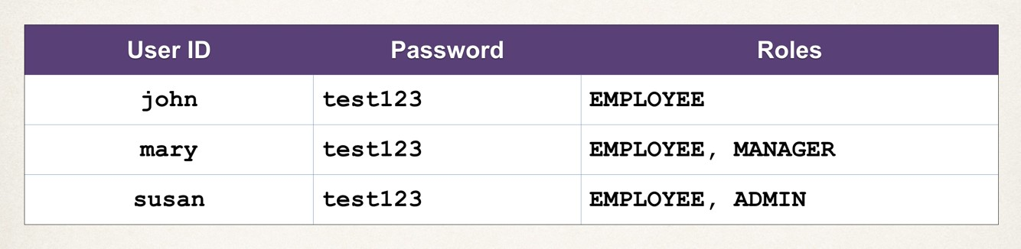


Step 1: Develop SQL Script to setup database tables
The password
INSERT INTO `users` VALUES
('john','{noop}test123',1),
('mary','{noop}test123',1),
('susan','{noop}test123',1);
www.luv2code.com

Slide 12




Step_{Th}1_{e}:_{e}D_{nco}e_{d}v_{in}e_{g}lop SQL Script to setup database tables
algorithm id
The password
INSERT INTO `users` VALUES
('john','{noop}test123',1),
('mary','{noop}test123',1),
('susan','{noop}test123',1);
Let’s Spring Security know the passwords are stored as plain text (noop)
www.luv2code.com

Slide 13


Step 1: Develop SQL Script to setup database tables
CREATE TABLE `authorities` (
`username` varchar(50) NOT NULL,
`authority` varchar(50) NOT NULL,
UNIQUE KEY `authorities_idx_1` (`username`,`authority`),
CONSTRAINT `authorities_ibfk_1` FOREIGN KEY (`username`) REFERENCES `users` (`username`)
) ENGINE=InnoDB DEFAULT CHARSET=latin1;
www.luv2code.com

Slide 14


Step 1: Develop SQL Script to setup database tables
www.luv2code.com

Slide 15





Step 1: Develop SQL Script to setup database tables
“authorities” same as “roles”
INSERT INTO `authorities` VALUES ('john','ROLE_EMPLOYEE'),
('mary','ROLE_EMPLOYEE'),
('mary','ROLE_MANAGER'),
('susan','ROLE_EMPLOYEE'),
('susan','ROLE_ADMIN');
Internally Spring Security uses “ROLE_” prefix
www.luv2code.com

Slide 16





Step 2: Add Database Support to Maven POM file
<!-- MySQL -->
<dependency>
<groupId>mysql</groupId>
<artifactId>mysql-connector-java</artifactId>
<version>5.1.45</version>
</dependency>
JDBC Driver
<!-- C3PO -->
<dependency>
<groupId>com.mchange</groupId>
<artifactId>c3p0</artifactId>
<version>0.9.5.2</version>
</dependency>
DB Connection Pool
www.luv2code.com

Slide 17

Step 3: Create JDBC Properties File
File: src/main/resources/persistence-mysql.properties
#
# JDBC connection properties #
jdbc.driver=com.mysql.jdbc.Driver jdbc.url=jdbc:mysql://localhost:3306/spring_security_demo?useSSL=false jdbc.user=springstudent
jdbc.password=springstudent
#
# Connection pool properties #
connection.pool.initialPoolSize=5 connection.pool.minPoolSize=5 connection.pool.maxPoolSize=20 connection.pool.maxIdleTime=3000
www.luv2code.com

Slide 18



Step 4: Define DataSource in Spring Configuration
File: DemoAppConfig.java
@Configuration @EnableWebMvc
@ComponentScan(basePackages = "com.luv2code.springsecurity.demo")
@PropertySource("classpath:persistence-mysql.properties") public class DemoAppConfig {
…
}
Will read the props file
src/main/resources
files are automatically
copied to classpath during Maven build
www.luv2code.com

Slide 19




Step 4: Define DataSource in Spring Configuration
…
public class DemoAppConfig {
@Autowired
private Environment env;
@Bean
public DataSource securityDataSource() {
// create connection pool
// set the jdbc driver
// set database connection props return securityDataSource;
}
}
Will hold data read from properties files
Need to define DataSource object
www.luv2code.com

Slide 20




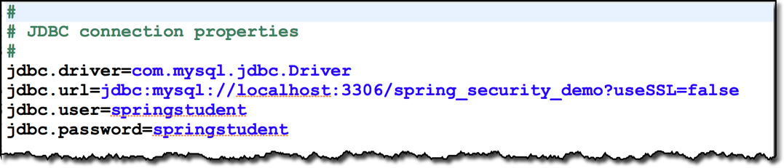
Step 4: Define DataSource in Spring Configuration
@Autowired
private Environment env;
private Logger logger = Logger.getLogger(getClass().getName());
@Bean
public DataSource securityDataSource() {
Read db configs
// create connection pool
ComboPooledDataSource securityDataSource = new ComboPooledDataSource();
// set the jdbc driver try {
securityDataSource.setDriverClass(env.getProperty("jdbc.driver"));
}
catch (PropertyVetoException exc) { throw new RuntimeException(exc);
}
…
www.luv2code.com

Slide 21



Step 4: Define DataSource in Spring Configuration
Read db configs
…
// for sanity's sake, let's log url and user ... just to make sure we are reading the data logger.info(">>>> jdbc.url=" + env.getProperty("jdbc.url"));
logger.info(">>>> jdbc.user=" + env.getProperty("jdbc.user"));
// set database connection props securityDataSource.setJdbcUrl(env.getProperty("jdbc.url")); securityDataSource.setUser(env.getProperty("jdbc.user")); securityDataSource.setPassword(env.getProperty("jdbc.password"));
www.luv2code.com

Slide 22
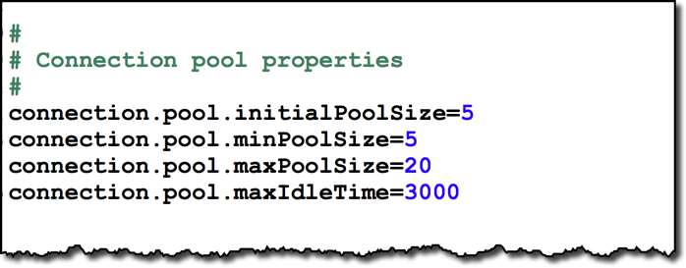

Step 4: Define DataSource in Spring Configuration
…
// for sanity's sake, let's log url and user ... just to make sure we are reading the data logger.info(">>>> jdbc.url=" + env.getProperty("jdbc.url"));
logger.info(">>>> jdbc.user=" + env.getProperty("jdbc.user"));
// set database connection props securityDataSource.setJdbcUrl(env.getProperty("jdbc.url")); securityDataSource.setUser(env.getProperty("jdbc.user")); securityDataSource.setPassword(env.getProperty("jdbc.password"));
// set connection pool props securityDataSource.setInitialPoolSize(Integer.parseInt(env.getProperty("connection.pool.initialPoolSize"))); securityDataSource.setMinPoolSize(Integer.parseInt(env.getProperty("connection.pool.minPoolSize"))); securityDataSource.setMaxPoolSize(Integer.parseInt(env.getProperty("connection.pool.maxPoolSize"))); securityDataSource.setMaxIdleTime(Integer.parseInt(env.getProperty("connection.pool.maxIdleTime")));
return securityDataSource;
}
www.luv2code.com

Slide 23






Step 5: Update Spring Security to use JDBC
@Configuration @EnableWebSecurity
public class DemoSecurityConfig extends WebSecurityConfigurerAdapter {
Inject our data source that we just configured
@Autowired
private DataSource securityDataSource;
@Override
protected void configure(AuthenticationManagerBuilder auth) throws Exception {
auth.jdbcAuthentication().dataSource(securityDataSource);
No longer
}
hard-coding users :-)
…
}
Tell Spring Security to use JDBC authentication with our data source
www.luv2code.com

